Slide 1
Automated Orphanage House Management System
Developed By : Jayesh Ahir

Slide 2
User Name : RegisterdUser Password : 123456

Slide 3
Project Contains
Project Specification
Introduction
SDLC
Data Flow Diagram
E-R Diagram
Data Dictionary
Screen Layout
Limitations
Bibliography
Future Enhancements

Slide 4
Project Specifications
Project Title : Automated Orphanage House Management Front End Tools : Asp.net , MVC, C#, CSS, Java Script Back End Tool : SQL Server Operating System : Microsoft windows 10 Web Server : IIS Web Browser : chrome Editor : Visual studio Hardware : 64-bit processor, 1.70 GHz, 4.00 GB RAM

Slide 5
System Development Strategy
As per the requirement of the project, We have choose
the Spiral as a strategy of developing the project, because
in Spiral-SDLC model starts with a small set of requirement
and goes through each development phase for those set of
requirements, so the appropriate strategy is spiral model.

Slide 6
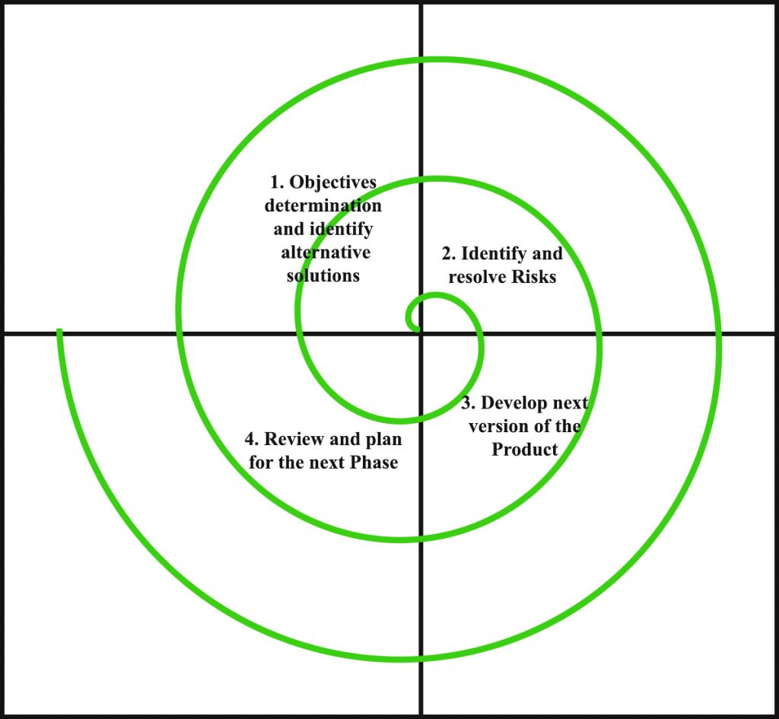
Spiral Module

Slide 7
Data Flow Diagram
A data-flow diagram (DFD) is a graphical representation of the "flow" of data through an information system. DFDs can also be used for the visualization of data processing (structured design).
On a DFD, data items flow from an external data source or an internal data store to an internal data store or an external data sink, via an internal process.

Slide 8
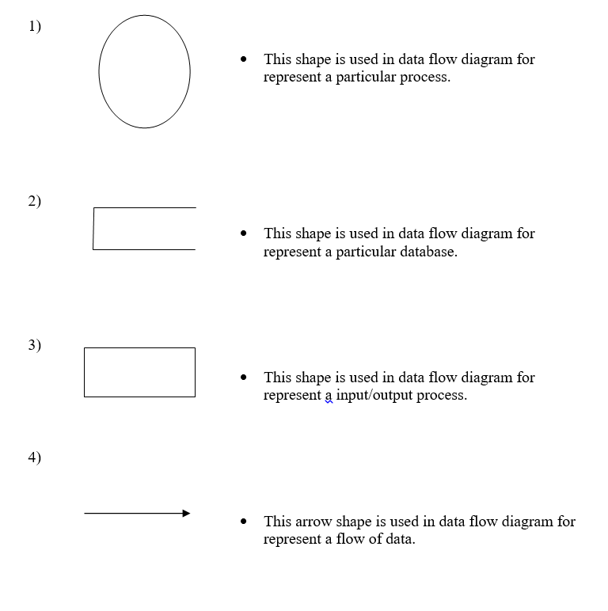

Slide 9

Home Header

Slide 10

Home footer

Slide 11

About Us

Slide 12

gallery

Slide 13
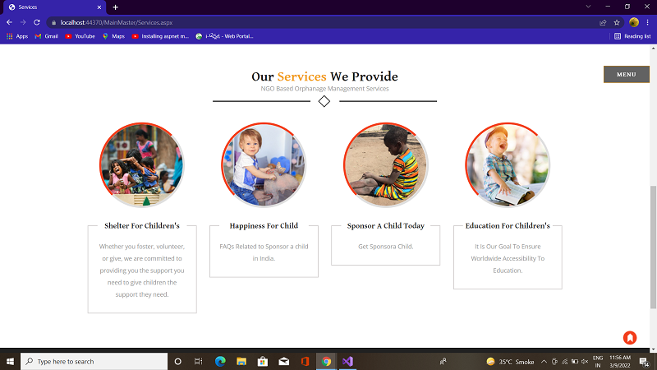
services

Slide 14
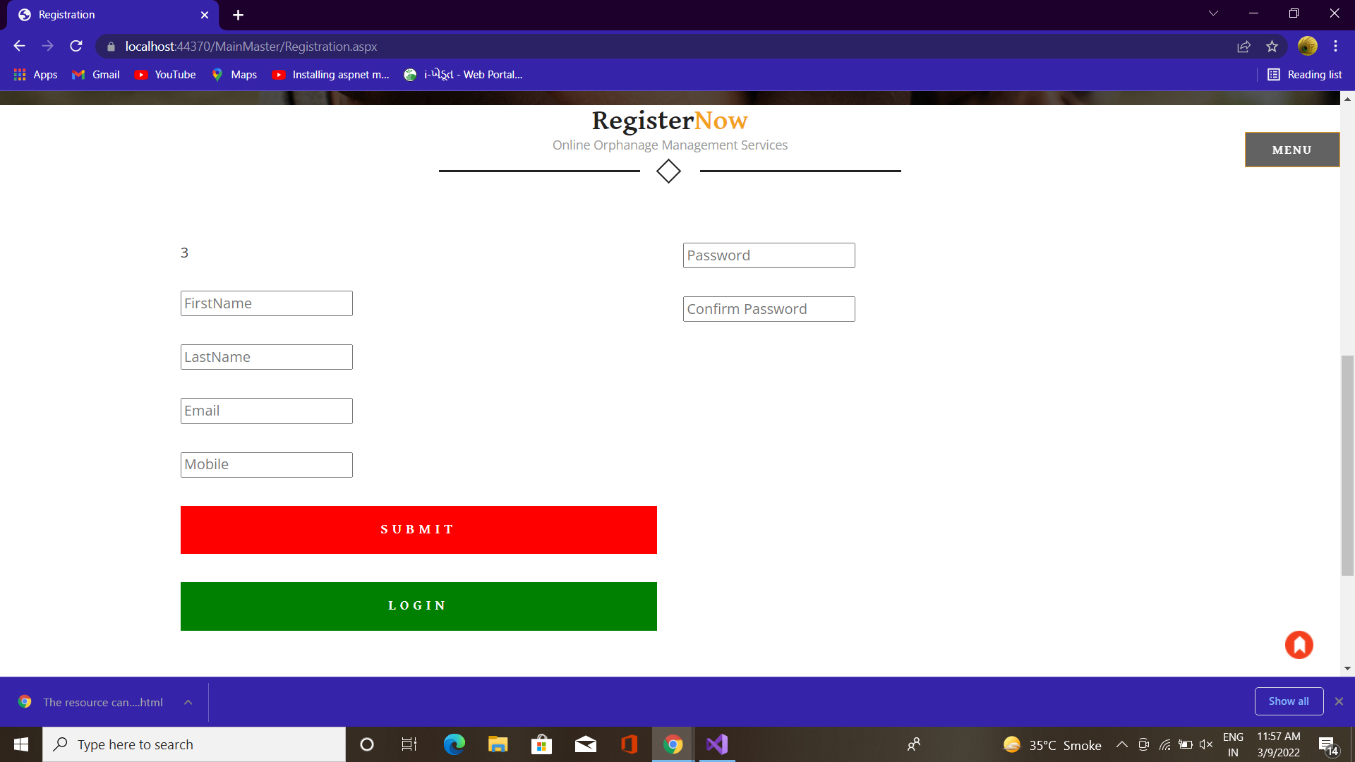
registration

Slide 15
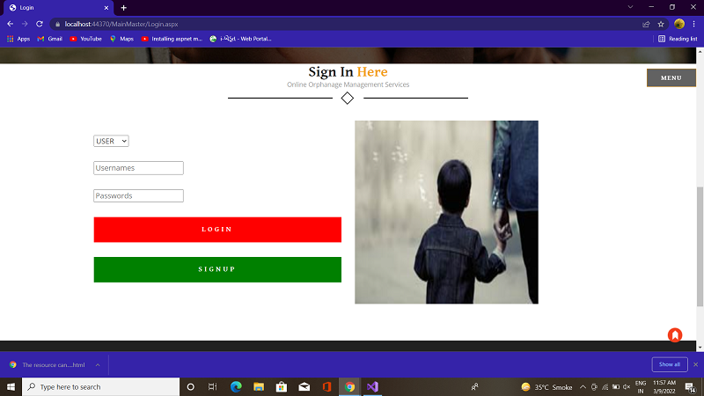
SignIn

Slide 16
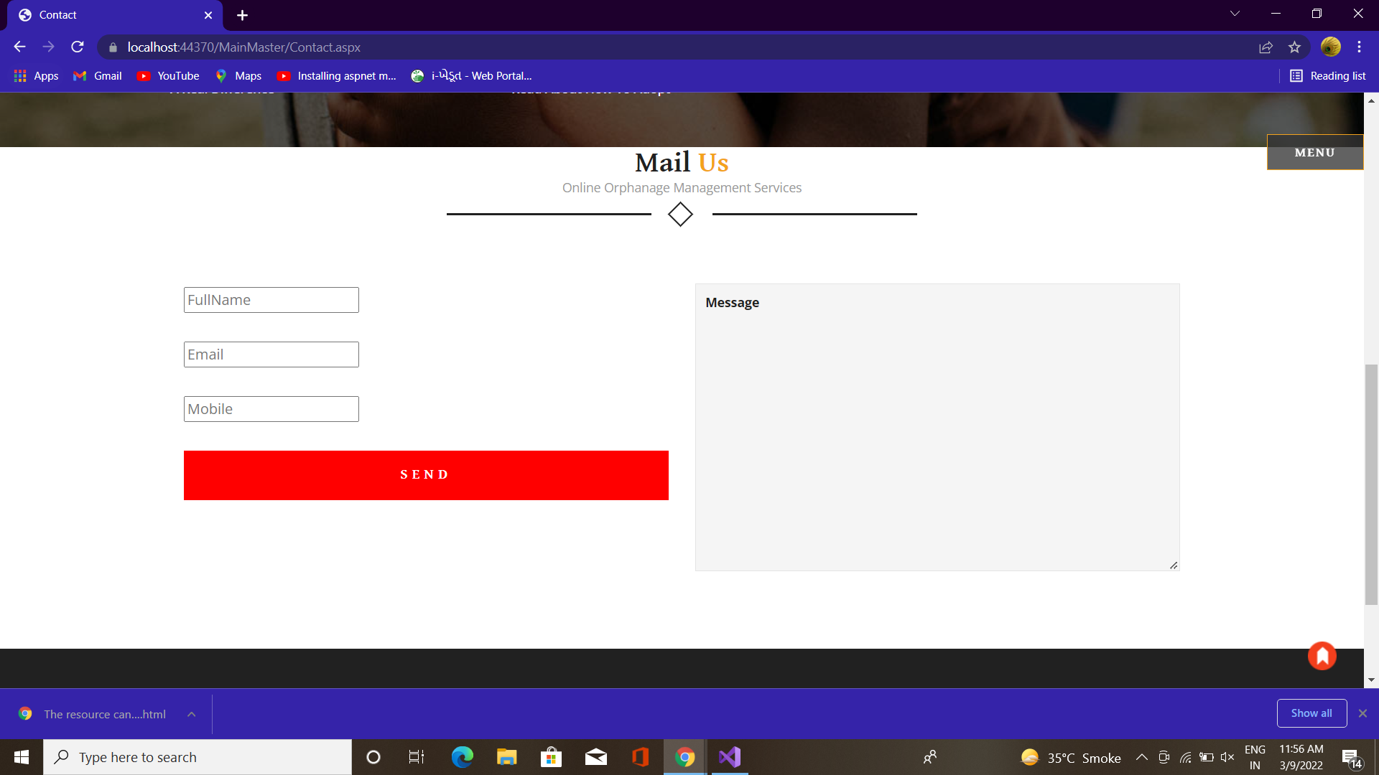
Contact

Slide 17

User Panel

Slide 18
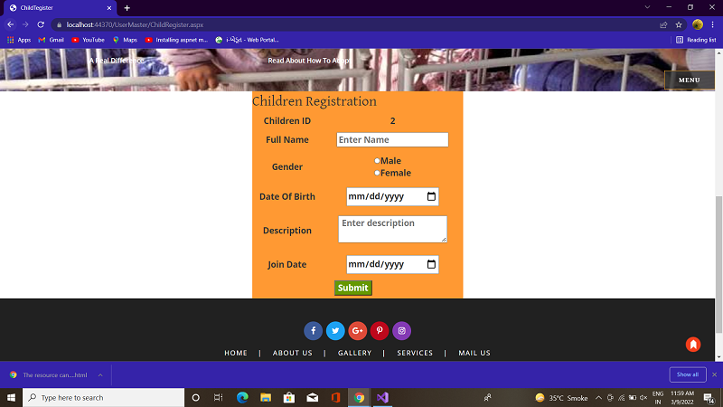
Child Registration

Slide 19

camp

Slide 20
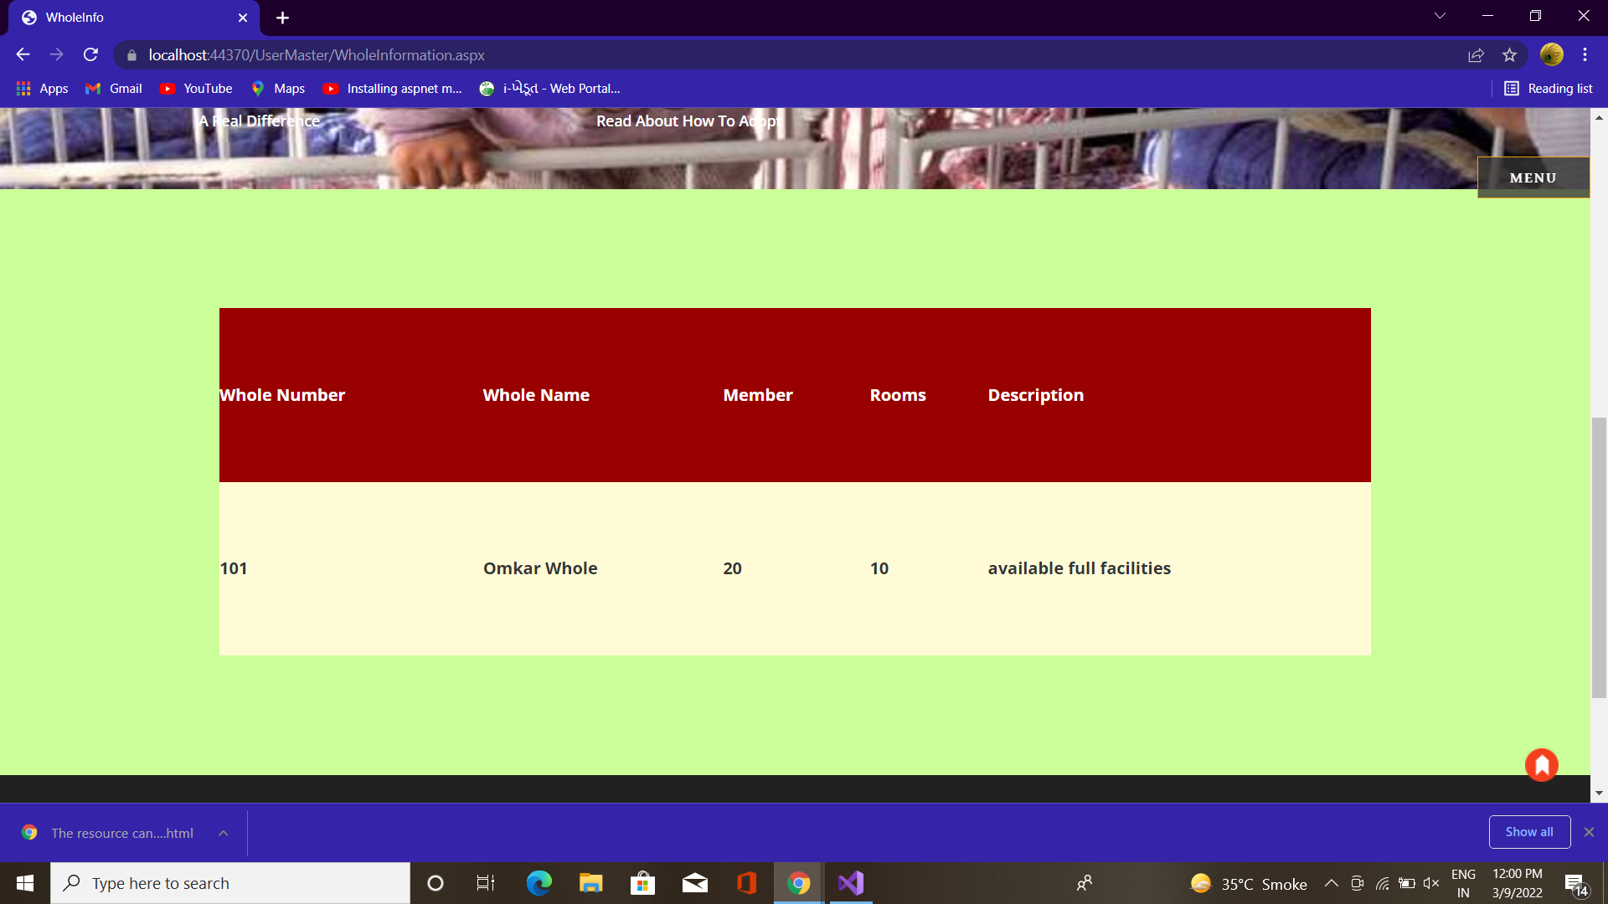
Whole Info

Slide 21
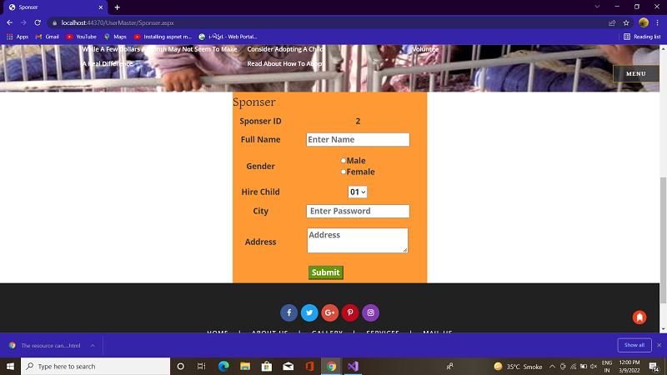
Sponsor

Slide 22

Admin Panel

Slide 23
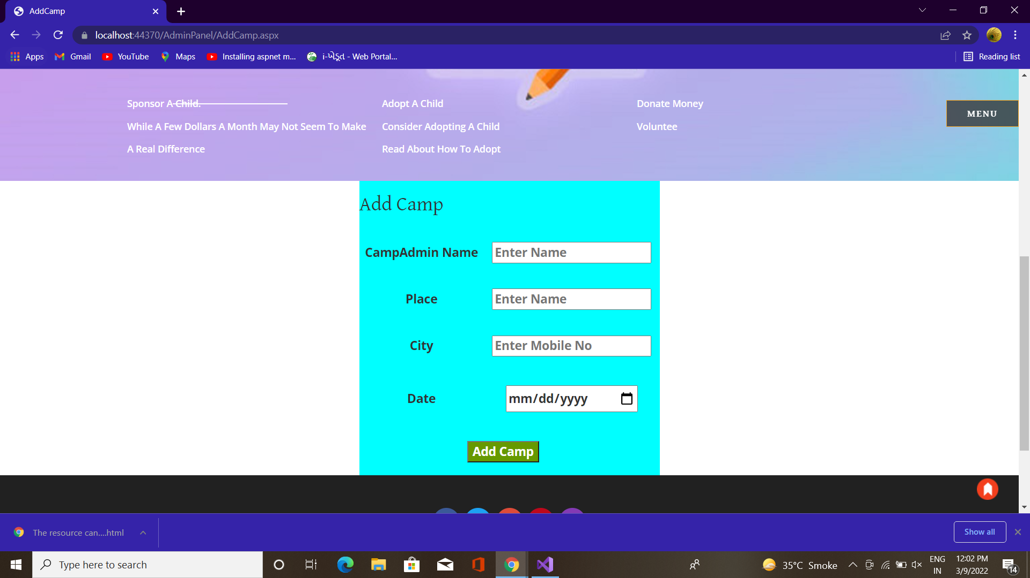
Add camp

Slide 24
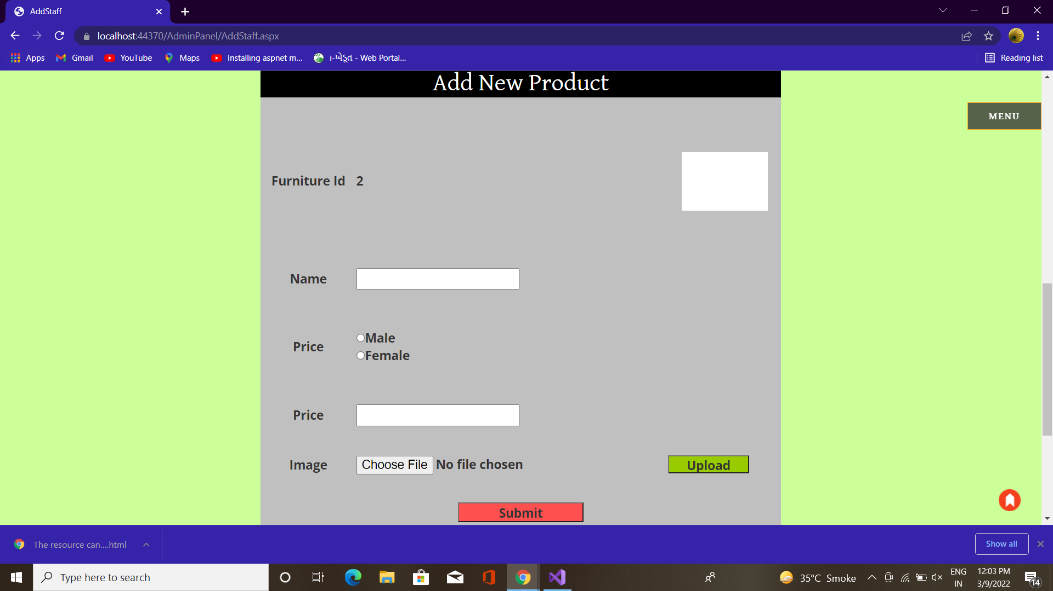
Add Staff

Slide 25
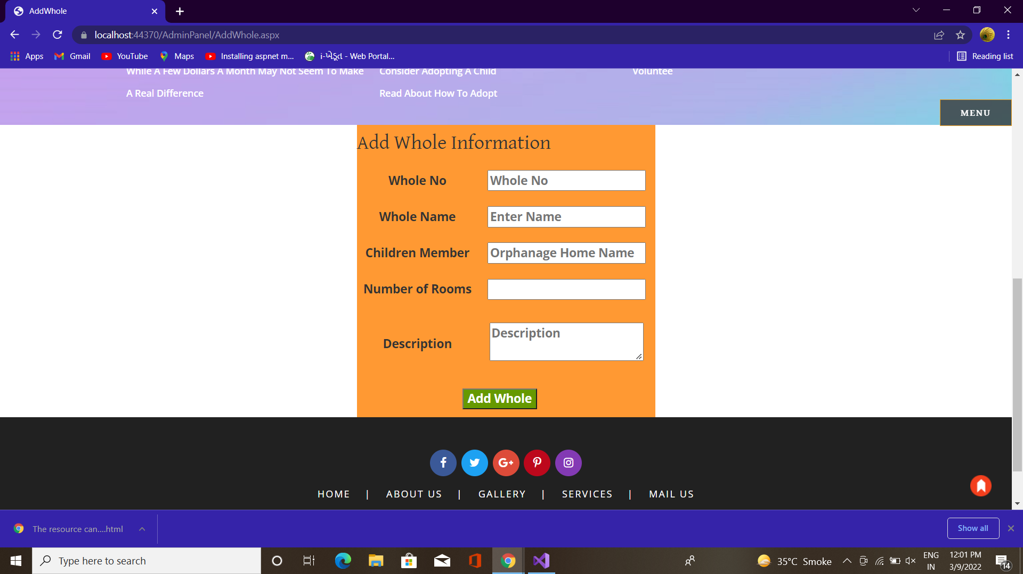
Add Whole Info

Slide 26
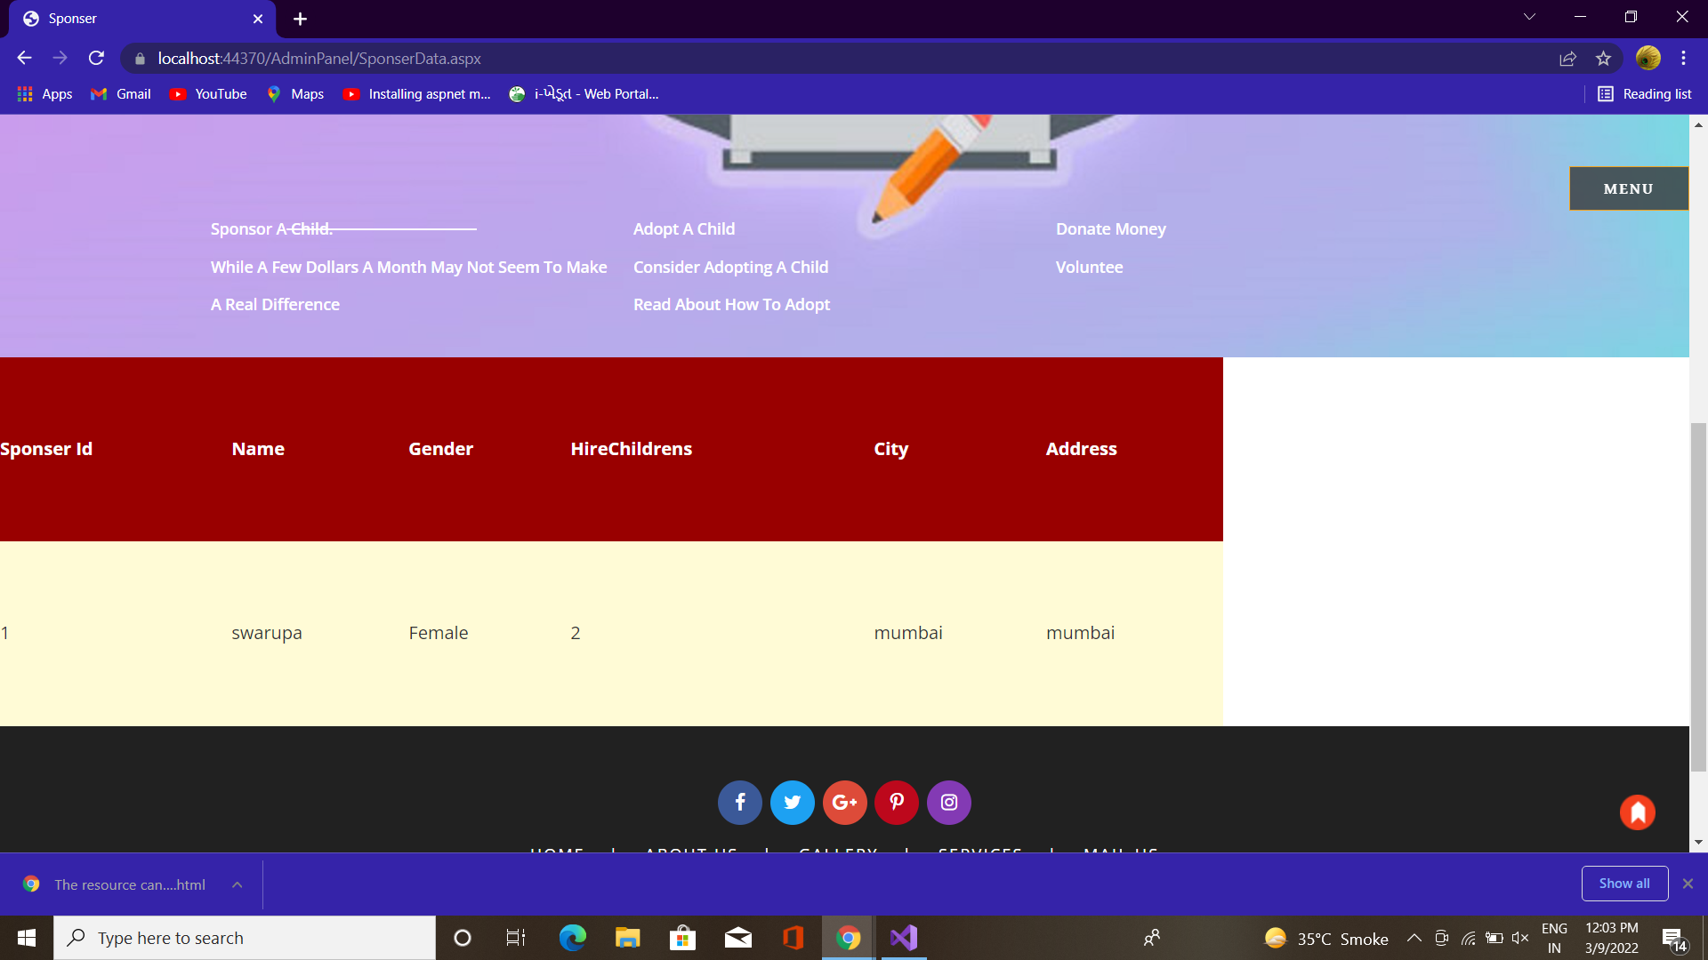
Sponsor Data

Slide 27
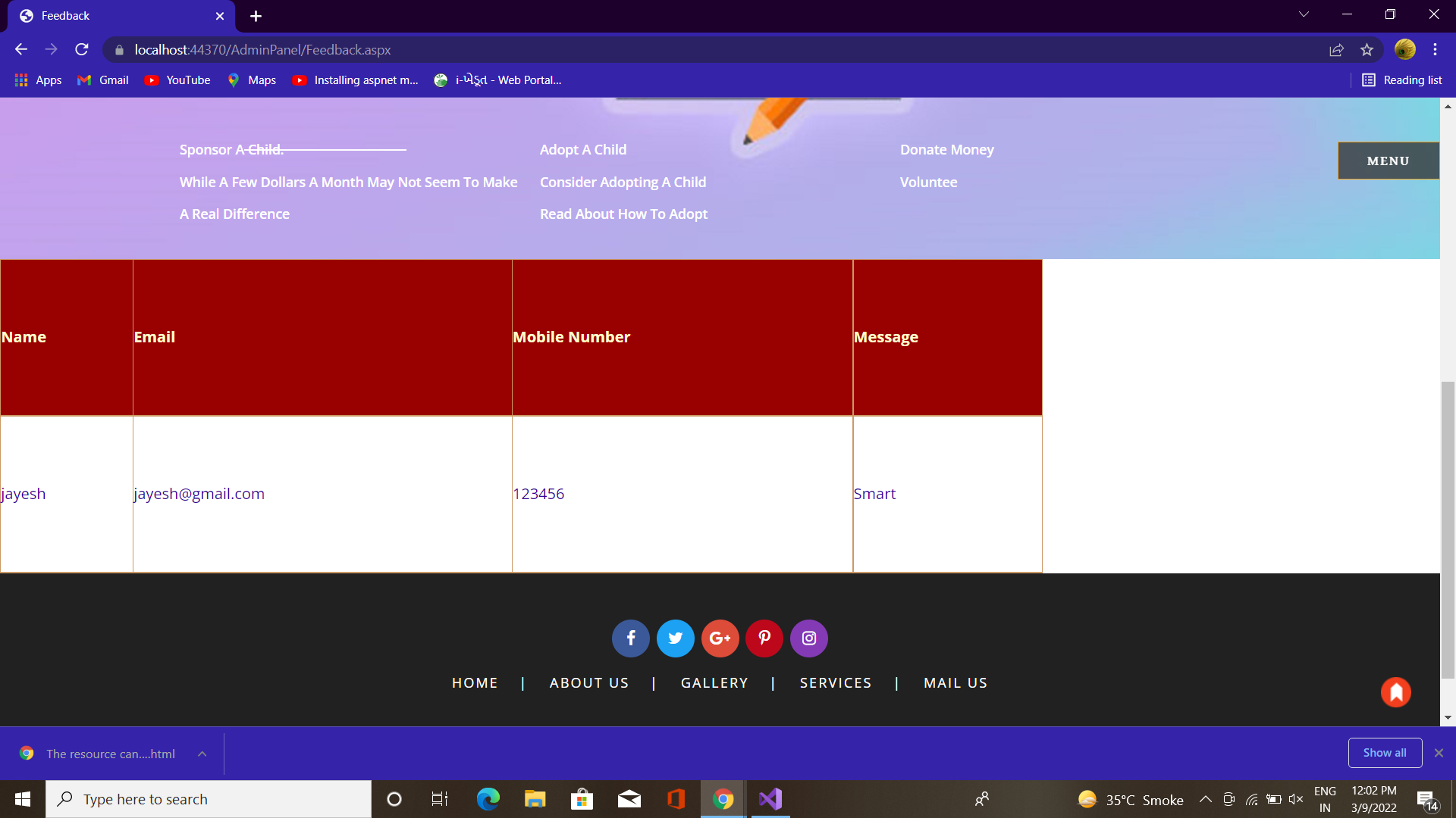
Review

Slide 28
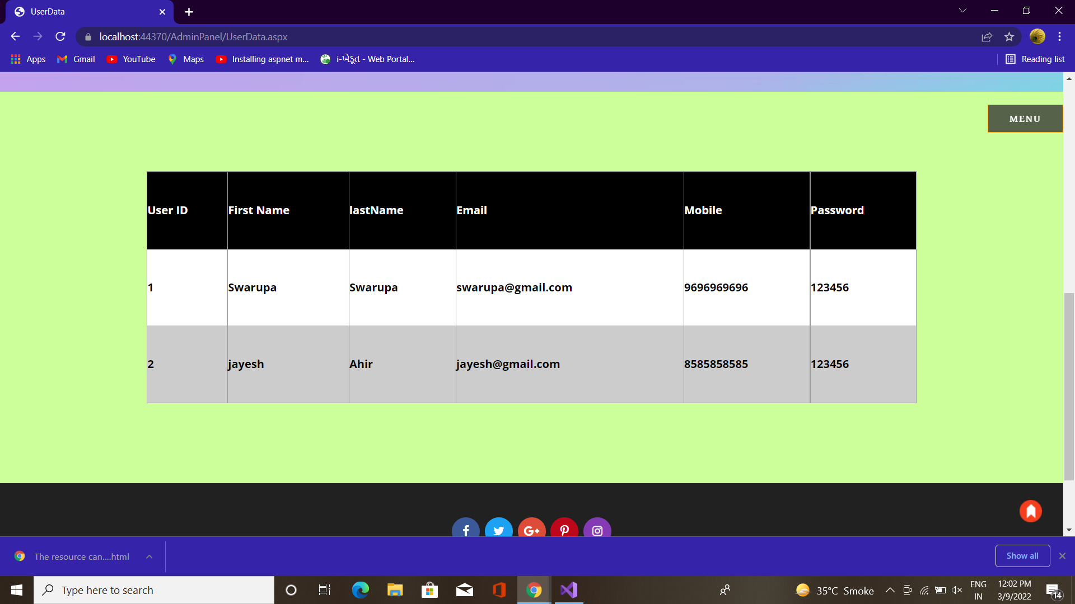
UserData

Slide 29
Testing and Implementation
Grey Box Testing
Grey Box testing is testing technique performed with limited information about the internal functionality of the system. Grey Box testers have access to the detailed design documents along with information about requirements.
Grey Box tests are generated based on the state-based models, UML Diagrams or architecture diagrams of the target system.
Black Box
White Box
Gray Box

Slide 30
Thank You..!

